Slide 1
Great Depression

Slide 2
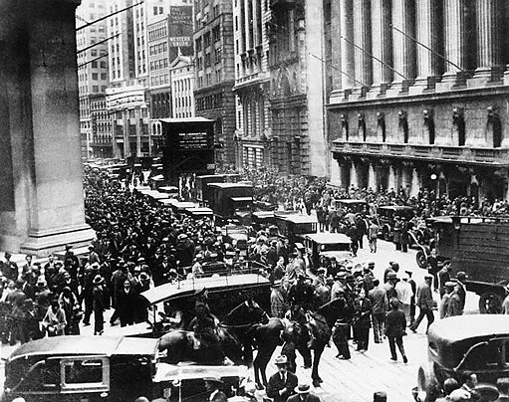
The Stock Market Crash of '29
Definition http://content.time.com/time/photogallery/0,29307,1677033_1474466,00.html
Hysteria on the Street
On the day of the collapse, the stock exchange lost $14 billion in value, ten times the annual budget of the federal government at that time.
New York, 1929

Slide 3
The Stock Market Crash of '29 http://content.time.com/time/photogallery/0,29307,1677033_1474466,00.html
A stock market crash is a sudden dramatic decline of stock prices across a significant cross-section of a stock market, resulting in a significant loss of paper wealth. Crashes are driven by panic as much as by underlying economic factors. They often follow speculative stock market bubbles.

Slide 4
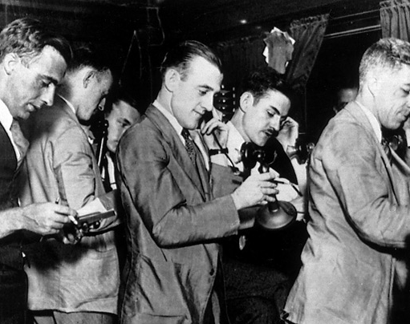
Black Thursday
Selling was triggered in part by a huge sell-off the preceding Thursday. Despite the efforts of brokers the following day (when this photo was taken) shares continued to decline, a trend dramatized by the newspapers in their weekend editions.
New York, 1929

Slide 5
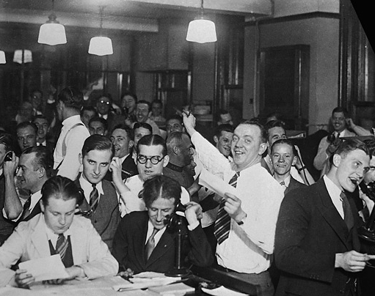
Trading Floor
As the downward slide continued, trading increased. Over 16 million shares were traded, a record not broken until 1969. During the panic, clerks worked for 48 straight hours.
New York, 1929

Slide 6
Trading Floor
The floor where trading activities are conducted. Trading floors are found in the buildings of various exchanges, such as the New York Stock Exchange and the Chicago Board of Trade. These floors represent the area where traders complete the buying or selling of an asset.

Slide 7
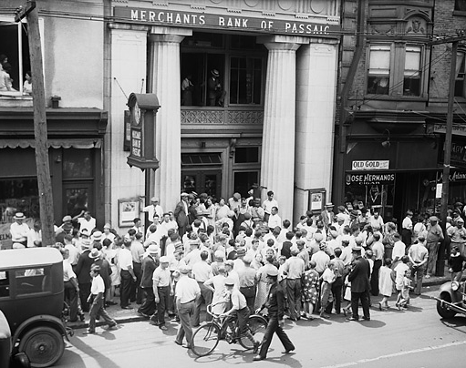
Run on the Bank
Panicked by the collapse of the market, customers of a bank in New Jersey race to
Passaic to claim their deposits.
Notes:
Write down the name of this slide What do you notice? Read the print. What conclusions can you put down?

Slide 8
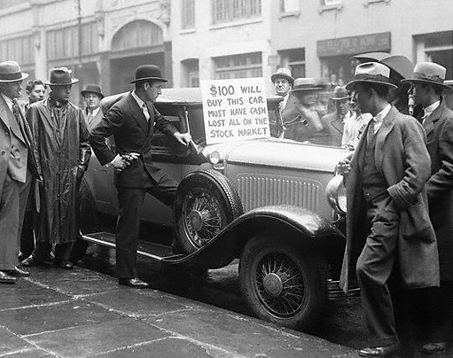
Desperate for Cash
A speculator tries to sell his car after losing all his money in the market. New York, 1929
Notes:
Write down the name of this slide. What do you notice? Read the print. What conclusions can you draw?

Slide 9
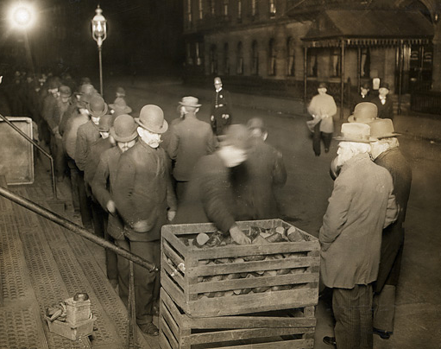
Hunger
The crash led to untold bankruptcies and business closures, causing many Americans to lose their jobs.
New York, 1929
Notes:
Write down the name of this slide. What do you notice? Read the print. What are those people probably thinking? Do you think they are talking with one another? Why or why not? What conclusions can you put down?

Slide 10
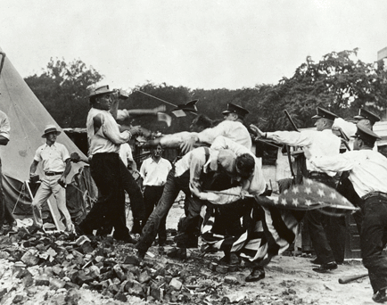
Bonus Army Marchers http://sites.austincc.edu/caddis/stock-market-crash-great-depression/
“Bonus Army Marchers Clash With Police In Washington, D.C., 1932. Many of the war veterans had been out of work since the beginning of the Great Depression. The World War Adjusted Compensation Act of 1924 had awarded them bonuses in the form of certificates they could not redeem until 1945. The principal demand of the Bonus Army was the immediate cash payment of their certificates.” Wikipedia
Notes:
Write down the name of this slide. What do you notice? Read the print. What conclusions can you draw?

Slide 11
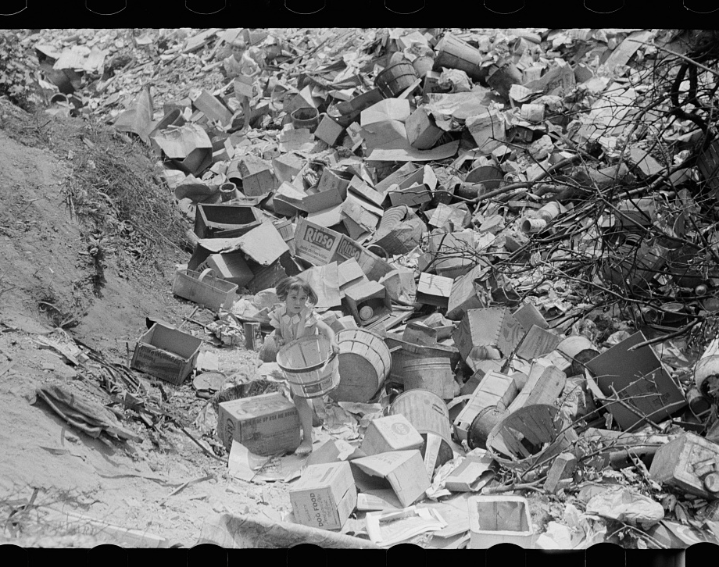
Arthur Rothstein http://photogrammar.yale.edu/records/index.php?record=fsa1997009951/PP
Children at city dump, Ambridge, Pennsylvania
1938
Notes:
Write down the name of this slide What do you notice? Read the print. What statement does the light exposure in this photograph make? What conclusions can you put down?

Slide 12
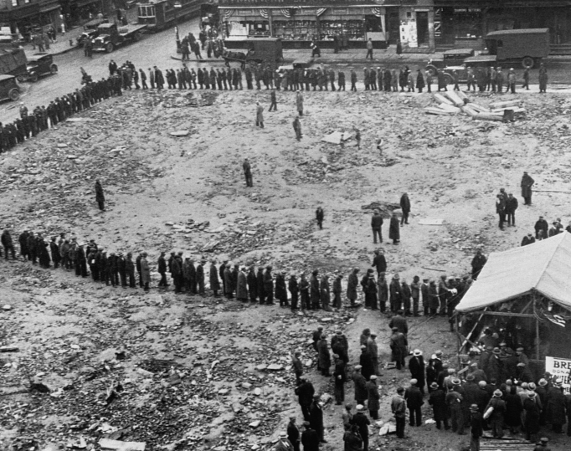
Bread Lines
By early 1955, more than 12 million people, or 25% of eligible workers, were unemployed.
http://www.history.com/topics/great-depression/pictures/soup-kitchens-and-breadlines/bread-line-in-depression-era-new-york
Notes:
Write down the name of this slide. What do you notice? What do you think people are waiting for? Read the print. What conclusions can you put down?

Slide 13
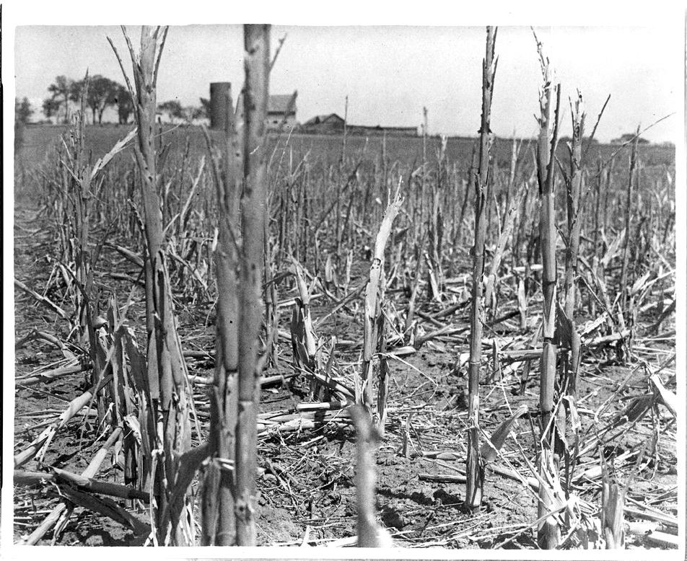
Drought
A corn field withered and broken by drought and wind in Shawnee County, Kan., 1936.
COURTESY KANSASMEMORY.ORG KANSAS HISTORICAL SOCIETY

Slide 14
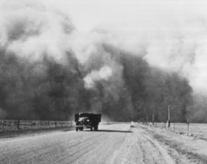
Dust Storm
A black blizzard over Prowers Co., Colorado, 1937. (Western History Collection, University of Oklahoma)
Notes:
Write down the name of this slide. What do you notice? Read the print. (Explain some of the dust storm background) What conclusions can you put down?

Slide 15
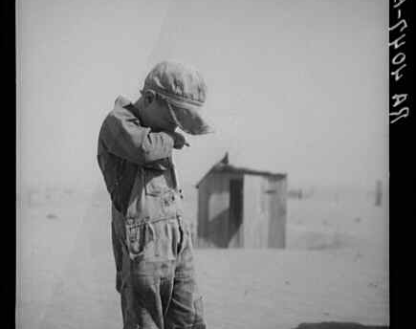
Dust Boy
Dust is too much for this farmer's son in Cimarron County, Oklahoma. Arthur Rothstein, photographer, 1936. (Library of Congress)
Notes:
Write down the name of this slide.

Slide 16
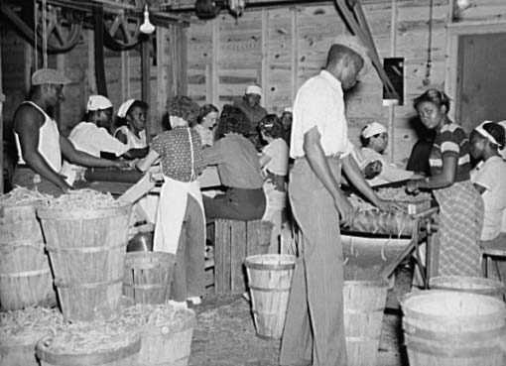
Dust Boy
Library of Congress, Washington, D.C., Arthur Rothstein (neg. no. LC-USF34-005788-D)
The Great Depression of the 1930s worsened the already bleak economic situation of African Americans. They were the first to be laid off from their jobs, and they suffered from an unemployment rate two to three times that of whites. In early public assistance programs African Americans often received substantially less aid than whites, and some charitable organizations even excluded blacks from their soup kitchens.
https://www.britannica.com/topic/African-American/African-American-life-during-the-Great-Depression-and-the-New-Deal
Notes:
Write down the name of this slide.

Slide 17
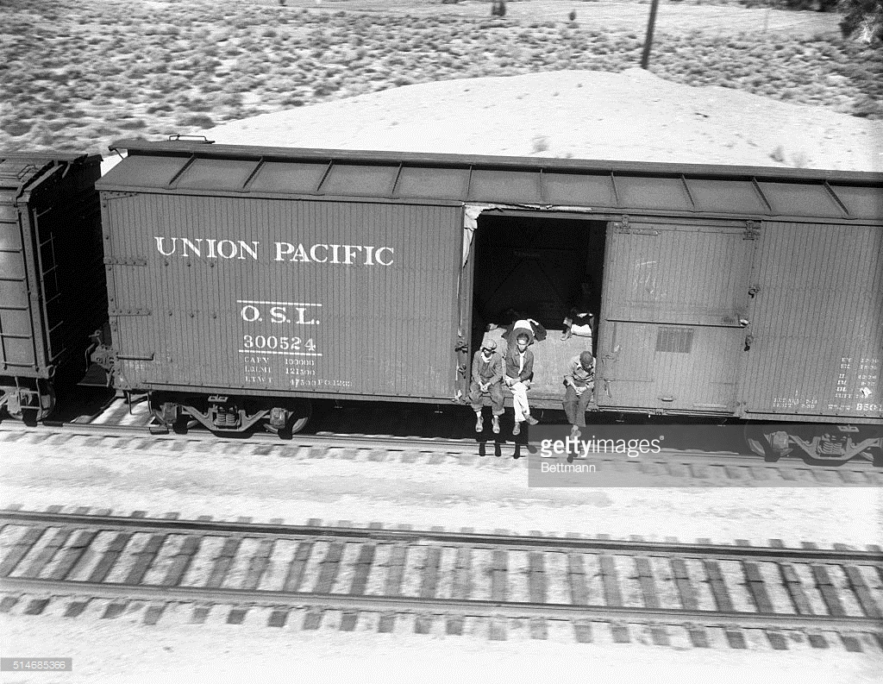
Hobos Riding Freight Car to California
Several hobos ride a freight car hanging over the side while others lay in the shade behind them. These hobos ride empty freight cars to Southern California.
October 23, 1934

Slide 18
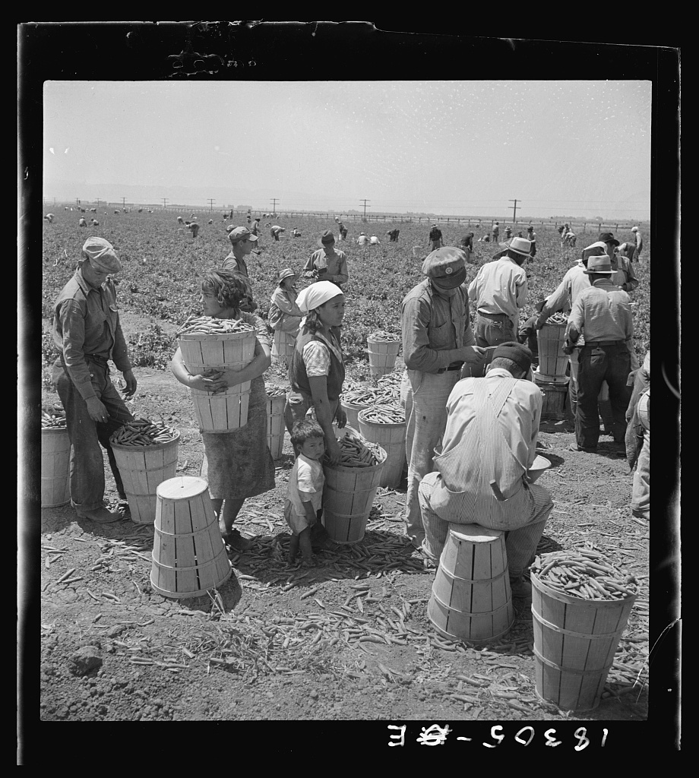
Dorothea Lange http://photogrammar.yale.edu/records/index.php?record=fsa2000001828/PP
Migrant pea pickers from many states line up with their filled hampers on the edge of the field. They wait their turn for weighing. Near Westley, California
Notes:
Write down the name of this slide. What do you notice about the ages of the people? Why do you think they are doing this?

Slide 19
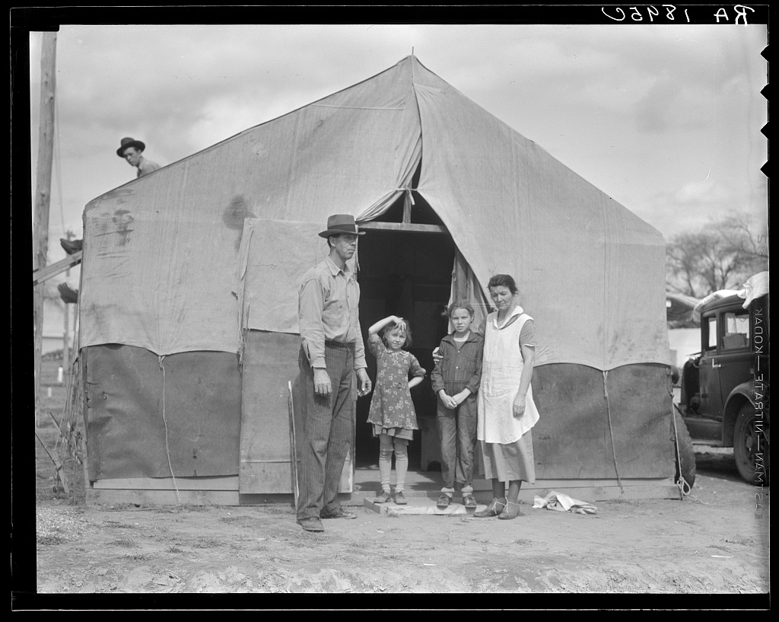
Dorothea Lange
Migrant Family http://photogrammar.yale.edu/records/index.php?record=fsa1998018331/PP
Migrant family in Kern County. This family was sent back at the state line by the Los Angeles police. Refused entrance into California, and it was only after they had gone back to Arkansas to borrow fifty dollars cash to show at the border that they were permitted to enter.
1936

Slide 20
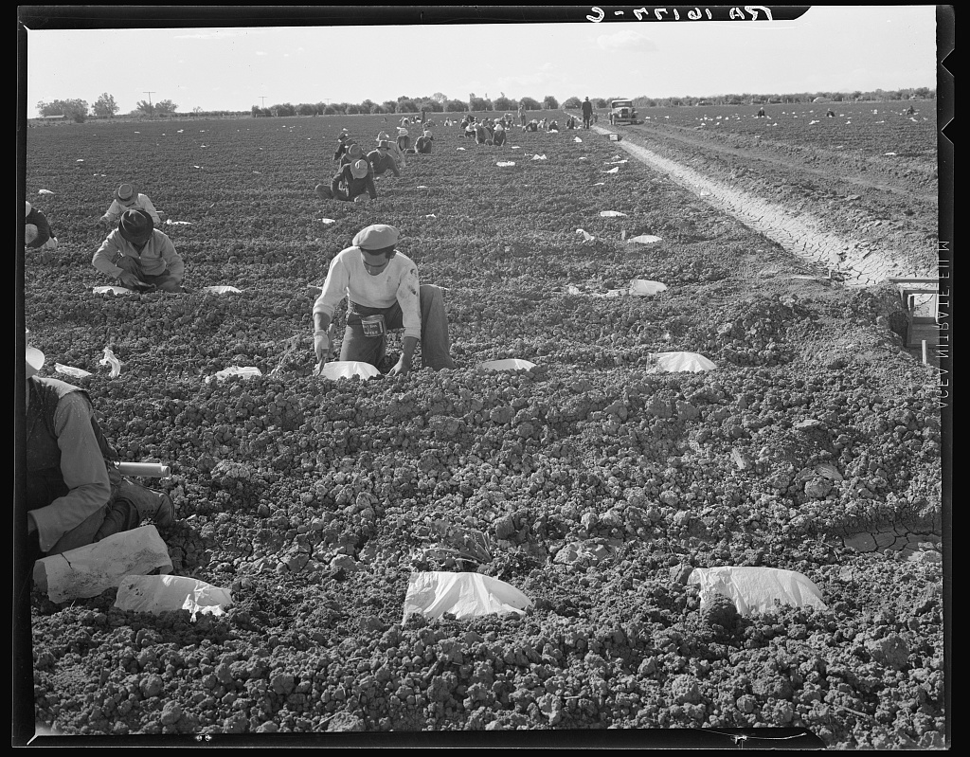
Dorothea Lange
Migrant Laborers http://photogrammar.yale.edu/records/index.php?record=fsa2000000853/PP
Mexican* migratory laborers under a Japanese field boss. These men are thinning and weeding cantaloupe plants. Wages were thirty cents an hour. These young plants are "capped" with wax paper spread over a wire wicket to protect against cold and to accelerate growth. Imperial Valley, California 1937

Slide 21
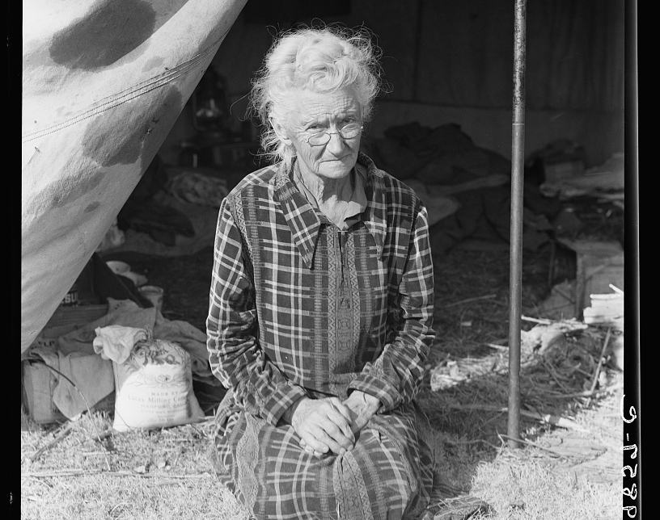
Dorothea Lange http://photogrammar.yale.edu/records/index.php?record=fsa1998021862/PP
Grandmother of twenty-two children, from a farm in Oklahoma; eighty years old. Now living in camp on the outskirts of Bakersfield, California. "If you lose your pluck you lose the most there is in you - all you've got to live with.” 1936

