Slide 1
Using EBSCO
Notes:
Total Script: There are many jobs in user experience, particularly with respect to making websites easier to use and more attractive to a customer. LAUSD Library services made some improvements to the user’s experience of accessing Destiny, our online catalog and Digital Library portal. All you have to do now is type LAUSD Destiny and type the name of your school.
Today, we are going to look specifically at the digital library. Let’s begin by choosing EBSCO and then Academic Search Premier.
Just by looking at the search box, what options do you notice there? What are they? What questions do you have about those options?
Let’s search this term, Restorative Justice in Schools
Take a look at just the first result. What are all the things you notice about just this first result? Let’s list those things and talk about what they are there for and how you can use them.
Without clicking on any particular result, what can we learn just by scrolling down the page and looking at the titles listed in the results?
Let’s look at the left hand side of the page under where it says refine results. What options are there? What can you find out by expanding those options?
Now let’s click on the first result. What do we see? What do we not see? (this one does not have the link to the full article).
Now let’s click on the second result. Find out how to cite it and how to access the article itself.
When you do a research paper, what do you think would be the best way to keep track of your articles?

Slide 2
Accessing the Digital Library
Notes:
There are many jobs in user experience, particularly with respect to making websites easier to use and more attractive to a customer. LAUSD Library services made some improvements to the user’s experience of accessing Destiny, our online catalog and Digital Library portal. All you have to do now is type LAUSD Destiny and type the name of your school.

Slide 3
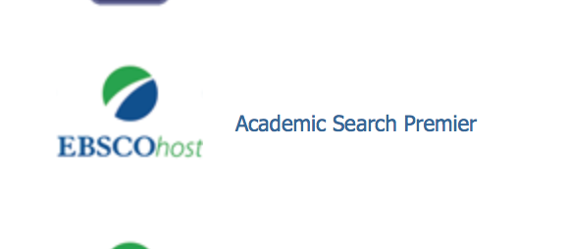
EBSCO
1
3
2
Notes:
Today, we are going to look specifically at the digital library. Let’s begin by choosing EBSCO and then Academic Search Premier.

Slide 4
Exploring Search Options
Notes:
Just by looking at the search box, what options do you notice there? What are they? What questions do you have about those options?

Slide 5
Studying a Result
Notes:
Let’s search this term, Restorative Justice in Schools
Take a look at just the first result. What are all the things you notice about just this first result? Let’s list those things and talk about what they are there for and how you can use them.
Without clicking on any particular result, what can we learn just by scrolling down the page and looking at the titles listed in the results?

Slide 6
Studying The Results Page
Notes:
Let’s search this term, Restorative Justice in Schools
Take a look at just the first result. What are all the things you notice about just this first result? Let’s list those things and talk about what they are there for and how you can use them.
Without clicking on any particular result, what can we learn just by scrolling down the page and looking at the titles listed in the results?

Slide 7
Refining Results
What options are there under Refine Results?
What can you find by expanding those options?
Notes:
Let’s look at the left hand side of the page under where it says refine results. What options are there? What can you find out by expanding those options?

Slide 8
Full Text or Abstract?
Notes:
Now let’s click on the first result. What do we see? What do we not see? (this one does not have the link to the full article).

Slide 9
Understanding the Result Page
Notes:
Now let’s click on the second result. Find out how to cite it and how to access the full text of the article?

Slide 10
Organizing Articles
Notecards?
EasyBib or online citation maker?
Word document where you cut and past citations?
Your own system?

